Slide 1
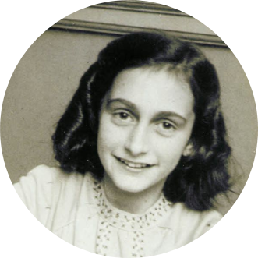
Anne Frank

Slide 2
Anne Frank ...growing up
Anne was born June 12, 1929 in Frankfurt am Main, Germany. She lived with her parents, Otto Heinrich Frank and Edith Hollander, and her older sister, Margot.
She grew up in a community of Jewish and Non-Jewish people.
Anne loved reading and writing.
When she turned 13 her family gave her a diary where she wrote all the feelings of the horrible situation.

Slide 3
The hiding begins...
On Monday, July 6, Anne and her family moved to a secret annex because the family received a call-up for Margot, Anne’s sister. If Margot didn’t assist in the work camp, the Nazis would arrest the whole family.
So the family left their home, making people believe they had moved to Switzerland.

Slide 4
Hiding...
They hid in the annex which was a small house that Jews used in the holocaust for hiding from the Nazis.
Where Anne stayed it was located behind her dad's office.
The Annex door was hidden by a bookcase for making sure the annex was safe and would not be discovered.

Slide 5
The Arrest...
On August 4, 1944, the Nazis found Anne’s hiding place and they took the family to a concentration camp. This was a 3-day journey.

Slide 6
The Westerbork...
Westerbork was the first concentration camp they were in. In this concentration camp they worked but it wasn’t too hard they still had some rights.

Slide 7
Auschwitz-Birkenau...
Auschwitz-Birkenau was the second concentration camp.
It was harder and men and women were separated.
They were forced to do heavy labor.
The Nazis shaved Anne’s head and put a tattoo on her arm with an identified number.
They were treated like slaves.

Slide 8
Bergen-Belsen...
Bergen-Belsen was the third concentration camp.
Anne and Margot (her sister) were moved to the third and last concentration camp.
Anne’s mother stayed in the second camp and died of starvation.
In this camp, Anne and Margot died of typhus some weeks before the camp was free from the Nazis.

Slide 9
Anne’s diary...
The only survivor from the family was her father who then was able to publish her diary.
Many people around the world read her diary to find out how Jewish people felt in those horrible times.

