Slide 1
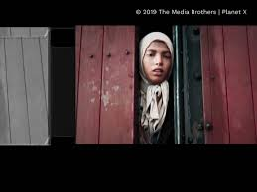

Slide 2
Settela Steinbach

Slide 3
Settela was born in the Netherlands, close to Germany. She had six brothers and sisters. Settela and her family were Sinti. The Nazis thought Sinti people were bad because they were different to them. The Nazis said all Sinti had to live in concentration camps. The Sinti had not done anything wrong. The Nazis put them in the prison camps just for being Sinti.

Slide 4
When Settela was in the first prison camp the Nazis decided they wanted to move her to another camp. The Nazis shaved Settela’s head. Settela tied a piece of cloth around her head to cover it. The Nazis put her in a train that had been used for animals. In this photo you can see Settela looking out of the train. The prison camp the Nazis moved Settela to was called Auschwitz. The Nazis killed Settela in Auschwitz.

Slide 5
If you are wondering what Auschwitz was, ‘Auschwitz’ was the name of a concentration camp where the Nazis kept people as prisoners and killed many of them. If you were a prisoner you were not allowed to leave the camp. The Nazis had many concentration camps and they killed millions of people in them.

Slide 6
THANK YOU
By Sonia
Age:10

